Slide 1
Standards for Measurement
Chapter 2
Outline
Measurements
Metric/SI System
Prefixes
Equalities
Types:
Mass/Weight
Length
Time
Volume
Temperature
Dimensional Analysis
Density

Slide 2
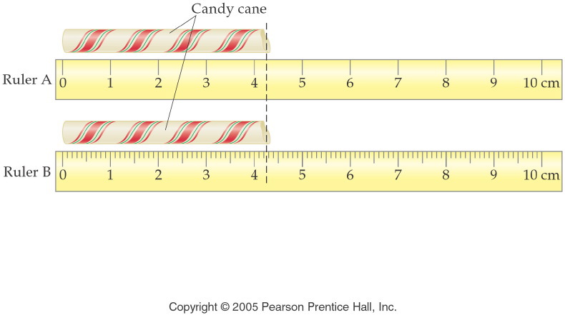
How long is the candy cane to the correct number of significant figures?
Notes:
Figure: 02-02
Title:
Metric Rulers
Caption:
On ruler A, each division is 1 cm. On ruler B, each division is 1 cm and each subdivision is 0.1 cm.
Notes:
These rulers are not to scale, but they reflect the relationship of measurement precision to instrumentation precision.

Slide 3
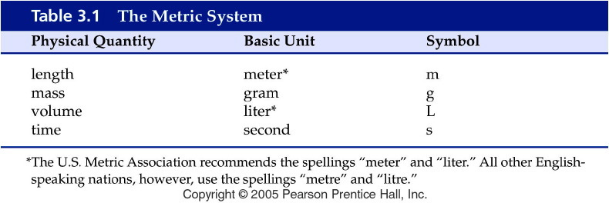
Notes:
Figure: 03-T01
Title:
Table 3.1
Caption:
The Metric System
Notes:
four basic metric (SI) units

Slide 4
Metric prefixes
kilo | k | 10³ or 1000 base units
deci | d | 10⁻¹ or 0.1 base units
centi | c | 10⁻² or 0.01 base units
milli | m | 10⁻³ or 0.001 base units
micro | μ | 10⁻⁶ or 0.000 001 base units
nano | n | 10⁻⁹ or 0.000 000 001 base units

Slide 5
Metric prefixes again
kilo | k | 1 kunit = 1000unit
deci | d | 10 dunit = 1unit
centi | c | 100 cunit = 1unit
milli | m | 1000 munit = 1unit
micro | μ | 1,000,000 μunit = 1unit
nano | n | 1,000,000,000 nunit = 1unit

Slide 7
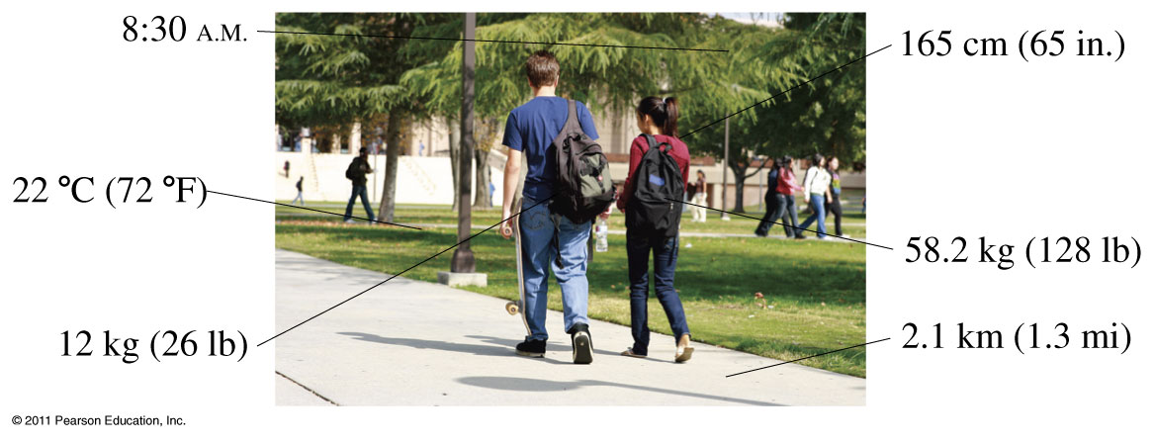
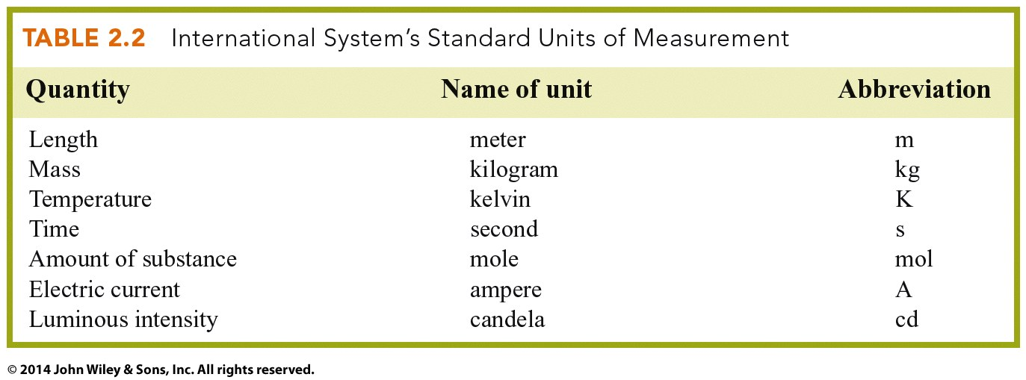
Units of Measure

Slide 9
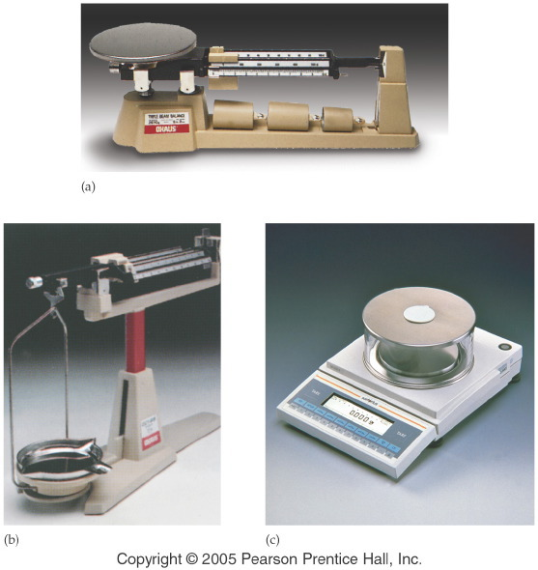
Notes:
Figure: 02-03
Title:
Balances for Measuring Mass
Caption:
(a) A platform balance having an uncertainty of 0.1 g. (b) A beam balance having an uncertainty of 0.01 g. (c) An electronic balance having an uncertainty of 0.001 g.
Notes:
Many labs have all three kinds of balances in use.

Slide 10
Dimensional Analysis Mass conversions
If someone weighs 53.8 kg, how much is this in pounds?

Slide 11
Dimensional Analysis Time conversions
How many days are in 2.5 decades?

Slide 12
Notes:
Figure: 02-05
Title:
Measuring Volume
Caption:
Graduated cylinders, syringes, burets, pipettes, and flasks are used to measure volume.
Notes:
While graduated cylinders, syringes, and burets are calibrated to measure varying amounts of liquid, they are not as precise as those used to measure a fixed volume.

Slide 13
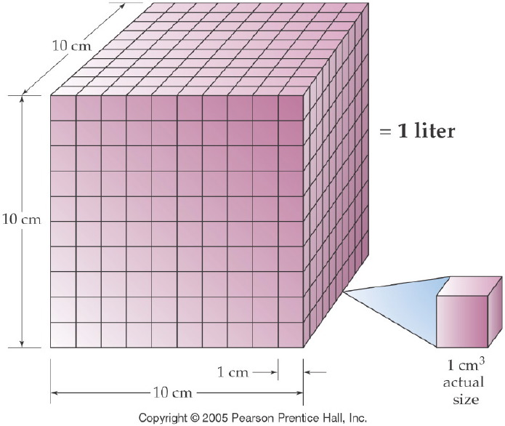
How is a liter related to length measurements?
Notes:
Figure: 03-01-09UN
Title:
One Liter
Caption:
A liter equals the volume of a cube 10 cm on a side, that is, 1000 cm³.
Notes:
This diagram is useful in explaining the difference between a length unit conversion (1 in = 2.54 cm) and a volume conversion ( (1 in)³ = (2.54 cm)³.

Slide 14
Dimensional Analysis Volume conversions
How many fluid ounces (fl. oz.) are in a 355 mL can of soda?

Slide 15
Dimensional Analysis Volume conversions
A sheet of aluminum has dimensions of 2.50 cm by 1.00 cm by 0.00150 cm.
What is the volume in cubic centimeters?
What is the volume in cubic millimeters?

Slide 16
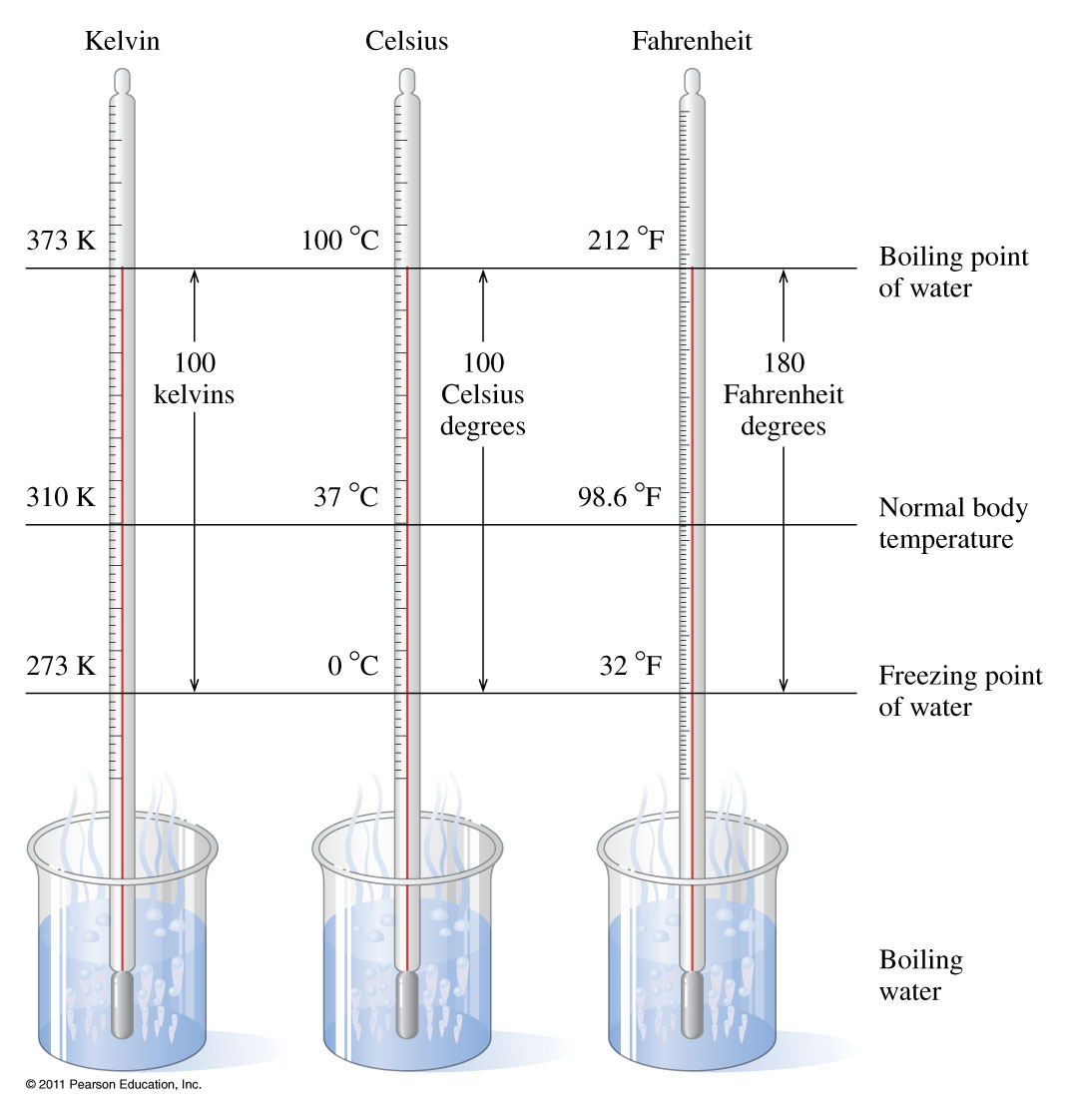
How do the temperature scales compare?

Slide 17
Example – Temperature Conversions
A young woman recovered from extreme hypothermia, during which her temperature had dropped to 20.6 ºC.
What was her temperature on the Fahrenheit scale?

Slide 18
Example – Temperature Conversions
A young woman recovered from extreme hypothermia, during which her temperature had dropped to 20.6 ºC.
What was her temperature on the Kelvin scale?

Slide 19
Example – Temperature Conversions
A 4-year-old child has a temperature of 38.7ºC. Since high fevers cause convulsions in children, it is recommended that Phenobarbital be given if the temperature exceeds 101.0ºF. Should Phenobarbital be given now?
Yes
No
Not enough information

Slide 20
Dimensional Analysis Percent concept
What percent iron is in stainless steel, if there are 11.176 g of iron in a 12.700 g sample of steel?

Slide 21
Dimensional Analysis Percent concept
Table salt, sodium chloride (NaCl), is composed of 39.3% sodium and 60.7% chlorine. Calculate the mass of sodium in 0.500 g of salt.

Slide 22
Dimensional Analysis Parts per million
The daily dose of ampicillin for the treatment of an ear infection is 115 mg/kg body weight (115 ppm). What is the daily dose for a 34-lb toddler?

Slide 23
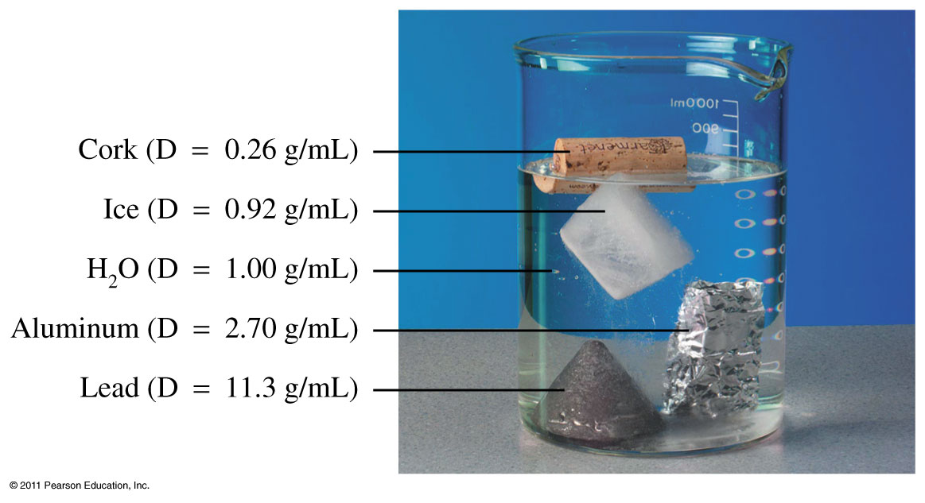

Slide 24
Which cube has the greater density?
$D=\frac{m}{V}$
Green cube
$m α D$

Slide 25
Which cube has the greater density?
$D=\frac{m}{V}$
Gray cube
$D α\frac{1}{V}$

Slide 26
Dimensional Analysis Density
A bottle containing 325 g of cleaning solution has fallen and broken on the floor. If the solution in the bottle has a density of 0.850 g/mL, what volume of solution needs to be cleaned up?

Slide 27
Dimensional Analysis Density
The density of gasoline is 0.69 g/mL. If 15.0 gallons of gas is pumped, how many grams is that?

Slide 28
Examples
How many inches are in 6.27 yds?
You have just won 2410 nickels in Las Vegas. How many $3 chips can you get to play with?

Slide 29
Convert 4.6 cm to nm.
Convert 750 ml to L.
A glass of orange juice contains 0.85 dL of juice. How many milliliters of orange juice is that?

Slide 30
The recommended daily allowance of phosphorus for an adult male is 800 mg. How many grams of phosphorus are recommended?
A student's height is 175 cm. How tall is the student in meters?
A hummingbird has a mass of 0.0055 kg. What is the mass of the hummingbird in grams?

Slide 31
Useful Conversion Factors
1 in = 2.54 cm
1lb = 454 g or 1 kg = 2.20 lb
1 qt = 946 ml or 1 L = 1.06 qt

Slide 32
A person is 60.0 in tall. What is this height in cm?
If someone weighs 80.7 kg, how much is this in pounds?

Slide 33
A person on a diet has been losing weight at the rate of 3.5 lb. per week. If the person has been on the diet for 6 weeks, how many kilograms were lost?

Slide 34
A plastics manufacturing plant uses 3.3 tons of oil per week. If oil costs $4.65/kg, how much will 1 years worth of oil cost the plastics manufacturer?

Slide 35
Mercury has a density of 13.6 g per mL. What is the density of mercury in lbs. per gallon?

Slide 36
Ebony is a dark hard wood. A rectangular piece of ebony has a mass of 522g and a volume of 435 cm³. Find the density of ebony.
Gasoline has a density of 0.68 g/mL. What is the mass of 90.5 mL of gasoline?

Slide 37
A bottle containing 325 g of cleaning solution has fallen and broken on the floor. If the solution in the bottle has a density of 0.850 g/mL, what volume of solution needs to be cleaned up?
A fish tank holds 30.0 gal of water. Using a density of 1.0 g/mL for water, determine the number of pounds of water in the fish tank.

Slide 38
Percentage
A sample of sugar weighing 2.47 g contains 0.988g of carbon. What is the mass % carbon in sugar?

Slide 39
Percentage (cont.)
Dr. Willard’s Chem115 class began with 127 students. Of the original enrollment, 11.2% received a final grade A. How many students earned an A?
Water is composed of 11.2% H and 88.8% O. What is the mass of water contains 15.0 g of O?

Slide 40
Jodi, a sculptor, has prepared a mold for casting a bronze figure. The figure has a volume of 325 mL. If bronze has a density of 7.8 g/mL and Jodi likes to use 90.0% of the bronze melted (she sometimes spills), how many ounces of bronze does Jodi need to melt in the preparation of the bronze figure.

Slide 41
Squared units
A poster has an area of 2 yd². What is the area of the poster in ft²?

